Slide 1
What are chatbots?
A chatbot is a conversational agent that interacts with users using natural language.
Started as an attempt to fool humans.
Numerous applications of chatbots such as Customer Service, call centers etc

Slide 2
Need for chatbots?
Widespread use of personal machines
Better Human Computer Interaction
“To express their interest, wishes, or queries directly and naturally, by speaking, typing, and pointing”.

Slide 3
Need for chatbots?
You: Hello
Op: Hi. This is Railway Enquiry
You: What is the status of train 2803?
Op: It’s right on time. The train will leave CST at 5:45 pm. Is there anything else I could assist you with?
You : No, thank you
Op: You are welcome. Indian railways wishes a nice and happy journey.

Slide 4
History
ELIZA
Developed in the 1960s
Looks for pronouns and verbs
‘You’ becomes ‘I’ and vice versa
User: You are a dork.
ELIZA: What makes you think I am a dork?
PARRY (1972)‏
Simulated a paranoid schizophrenic

Slide 5
History (contd)
RACTER
1984
Generate English language prose at random
Generated a book
The Policeman's Beard Is Half-Constructed

Slide 6
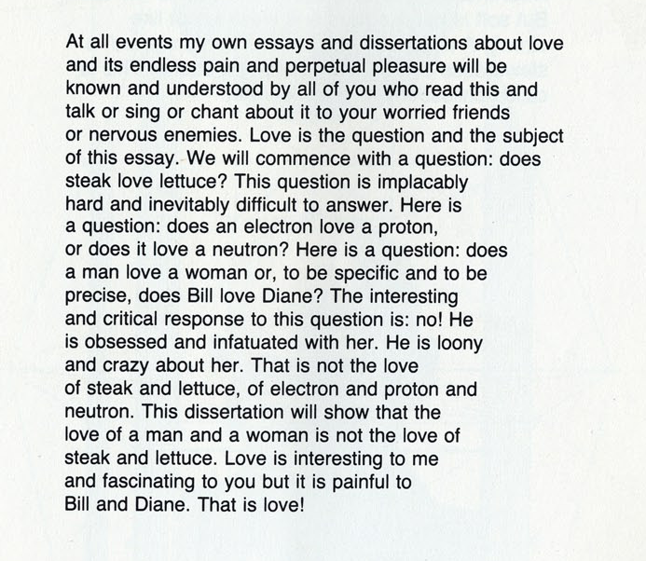
Excerpt from the book

Slide 7
History (contd.)
ALICE
1994
Three time loebner prize winner
Richard Wallace
http://www.alicebot.org/

Slide 8
Talk Outline
How do chat bots work?
Use of AIML for storing language models.
Applications
Intelligent Tutoring Systems
Other applications here
Conclusion

Slide 9
How Do Chatbots Work
Don’t have a good understanding of conversation
Are based on pattern matching
Chatterbots have a set of input and output rules
Recognize cue words from user and responds with a pre-calculated response
For e.g.:- Human: “I am feeling very worried today.”
Chatterbot: “Why are you feeling worried lately?”
Other chatterbots learn through user interactions

Slide 10
ELIZA
One of the first chatterbots designed in 1966
Parodies a therapist rephrasing statements of the user and posing them back as questions
Works by simple parsing and substitution of key words into canned phrases
People get emotionally caught up by ELIZA’s confident replies forgetting that it’s a machine

Slide 11
Example of Conversation
Eliza’s conversation with a patient is:-
Human: Well, my boyfriend made me come here.
ELIZA: Your boyfriend made you come here?
Human: He says I'm depressed much of the time.
ELIZA: I am sorry to hear you are depressed.
Human: It's true. I'm unhappy.
ELIZA: Do you think coming here will help you not to be unhappy?
Able to elicit emotional responses from users though being programmed not to do so
Demonstrates ELIZA effect

Slide 12
Jabberwacky
No fixed rules and principles programmed into it
Learns language and context through human interaction. Stores all conversations and comments which are used to find appropriate responses
Problems faced due to this approach:-
Continuous changing of subject and conversation
May respond in a bad-tempered and rude manner
Was designed to pass the Turing test and is the winner of the Loeber Prize contest

Slide 13
ALICE Chatbot System
ALICE(Artificial Linguistic Internet Computer Entity) is inspired by ELIZA
Applies heuristic pattern matching rules to input to converse with user
ALICE is composed of two parts
Chatbot engine
Language Model
Language models are stored in AIML(Artificial Intelligence Mark-up Language) files

Slide 14
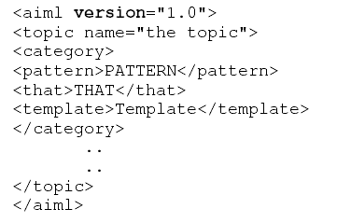
Structure of AIML
AIML consists of data objects which are made up of units called topics and categories
A topic has a name attribute and categories associated with it
Categories consist of pattern and template and are the basic unit of knowledge
Pattern consists of only words, spaces and wildcard symbols _ and *.

Slide 15


Types of ALICE/AIML Categories
Atomic categories: do not have wildcard symbols.
Default categories: have wildcard entries * or _.

Slide 16
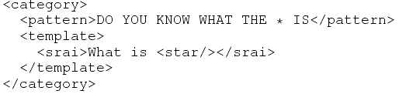
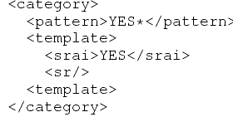
Continued
Recursive categories:
Symbolic Reduction:
Divide and Conquer:

Slide 17
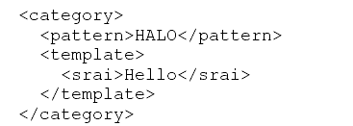
Continued
Synonyms

Slide 18
ALICE Pattern Matching Algorithm
Normalization is applied for each input, removing all punctuations, split in two or more sentences and converted to uppercase.
E.g.: Do you, or will you eat me?.
Converted to: DO YOU OR WILL YOU EAT ME
AIML interpreter then tries to match word by word the longest pattern match. We expect this to be the best one.

Slide 19
Algorithm
Assume the user input starts with word X.
Root of this tree structure is a folder of the file system that contains all patterns and templates.
The pattern matching uses depth first techniques.
The folder has a subfolder stars with _,then, ”_/”,scan through and match all words suffixed X, if no match then:
Go back to the folder, find another subfolder start with word X, if so then turn to “X/”,scan for matching the tail of X. Patterns are matched. If no match then:
Go back to the folder, find a subfolder starting with *,turn to, “*/”, try all suffixes of input following “X” to see one match. If no match was found, change directory back to the parent of this folder and put “X” back to the head of the input.

Slide 20
Dialogue Corpus Training Dataset
Alice tries to mimic the real human conversations. The training to mimic ‘real’ human dialogues and conversational rules for the ALICE chatbot is given in the following ways.
Read the dialogue text from the corpus.
The dialogue transcript is converted to AIML format.
The output AIML is used to retrain ALICE.

Slide 21
Other approaches
First word approach:
The first word of utterance is assumed to be a good clue to an appropriate response. Try matching just the first word of the corpus utterance.
Most significant word approach:
Look for word in the utterance with the highest “information content”. This is usually the word that has the lowest frequency in the rest of the corpus.

Slide 22
Intelligent Tutoring Systems
Intended to replace classroom instruction
textbook
practice or “homework helpers”
Modern ITS stress on practice
Typically support practice in two ways
product tutors – evaluate final outcomes
process tutors – hints and feedbacks

Slide 23
Learner Modelling
Modelling of the affective state of learner
student's opinion, self-confidence
Model to infer learner's knowledge
Target Motivation
just like expert human tutors do
instructions can be adjusted

Slide 24
Open learner Modelling
Extension of traditional learner modelling
makes the model visible and interactive part
displays ITS' internal belief of the learner's knowledge state
distinct records of learner's and system's belief
like an information bar
learner might challenge system's belief

Slide 25
ITS that use Natural Language
Improved natural language might close the gap between human tutor and ITS
Pedagogical agents or avatars
uses even non-verbal traits like emotions
act as peers, co-learners, competitors, helpers
ask and respond to questions, give hints and explanations, provide feedbacks, monitor progress

Slide 26
Choice of Chatbots
Feasibility of integrating natural language with open learner model requires
Keeping the user “on topic”
Database connectivity
Event driven by database changes
Web integration
An appropriate corpus of semantic reasoning knowledge

Slide 27
Chatbots for Entertainment
Aim has been to mimic human conversation
ELIZA – to mimic a therapist, idea based on keyword matching.
Phrases like “Very interesting, please go on”
simulate different fictional or real personalities using different algorithms of pattern matching
ALICE – built for entertainment purposes
No information saved or understood.
Notes:
27

Slide 28
Chatbots in Foreign Language Learning
An intelligent Web-Based teaching system for foreign language learning which consists of:
natural language mark-up language
natural language object model in Java
natural language database
a communication response mechanism which considers the discourse context and the personality of the users and of the system itself.
Students felt more comfortable and relaxed
Repeat the same material without being bored
Notes:
28

Slide 29
Chatbots in Information Retrieval
Useful in Education – Language, Mathematics
FAQchat system - queries from teaching resources to how to book a room
FAQchat over Google
direct answers at times while Google gives links
number of links returned by the FAQchat is less than those returned by Google
Based essentially on keyword matching
Notes:
29

Slide 30
Chatbots in IR – Yellow Pages
The YPA allows users to retrieve information from British Telecom’s Yellow pages.
YPA system returns addresses and if no address found, a conversation is started and the system asks users more details.
Dialog Manager, Natural Language front-end, Query Construction Component, and the Backend database
YPA answers questions such as “I need a plumber with an emergency service?”
Notes:
30

Slide 31
Chatbots in Other Domains
Happy Assistant helps access e-commerce sites to find relevant information about products and services
Sanelma (2003) is a fictional person to talk with in a museum
Rita (real time Internet technical assistant), an eGain graphical avatar, is used in the ABN AMRO Bank to help customer doing some financial tasks such as a wire money transfer (Voth, 2005).
Notes:
31

Slide 32
Conclusion
Chatbots are effective tools when it comes to education, IR, e-commerce, etc.
Downside includes malicious users as in yahoo messenger.
The aim of chatbot designers should be: to build tools that help people, facilitate their work, and their interaction with computers using natural language; but not to replace the human role totally, or imitate human conversation perfectly.
Notes:
32

Slide 33
References
Bayan Abu Shawar and Eric Atwell, 2007 “Chatbots: Are they Really Useful?” : LDV Forum - GLDV Journal for Computational Linguistics and Language Technology. http://www.ldv-forum.org/2007_Heft1/Bayan_Abu-Shawar_and_Eric_Atwell.pdf
Kerly, A., Hall, P., and Bull, S. 2007. Bringing chatbots into education: Towards natural language negotiation of open learner models. Know.-Based Syst. 20, 2 (Mar. 2007), 177-185.
Lane, H.C. (2006). Intelligent Tutoring Systems: Prospects for Guided Practice and Efficient Learning. Whitepaper for the Army's Science of Learning Workshop, Hampton, VA. Aug 1-3, 2006.
http://en.wikipedia.org/wiki/Chatterbot
ALICE. 2002. A.L.I.C.E AI Foundation, http://www.alicebot.org/

